Slide 1

Living in a family with Huntington’s disease: Views from children and youth
European Conference on Huntington’s disease
Sofia, Bulgaria September 22, 2017
Melinda S. Kavanaugh, PhD, MSW, LCSW
Helen Bader School of Social Welfare

Slide 2
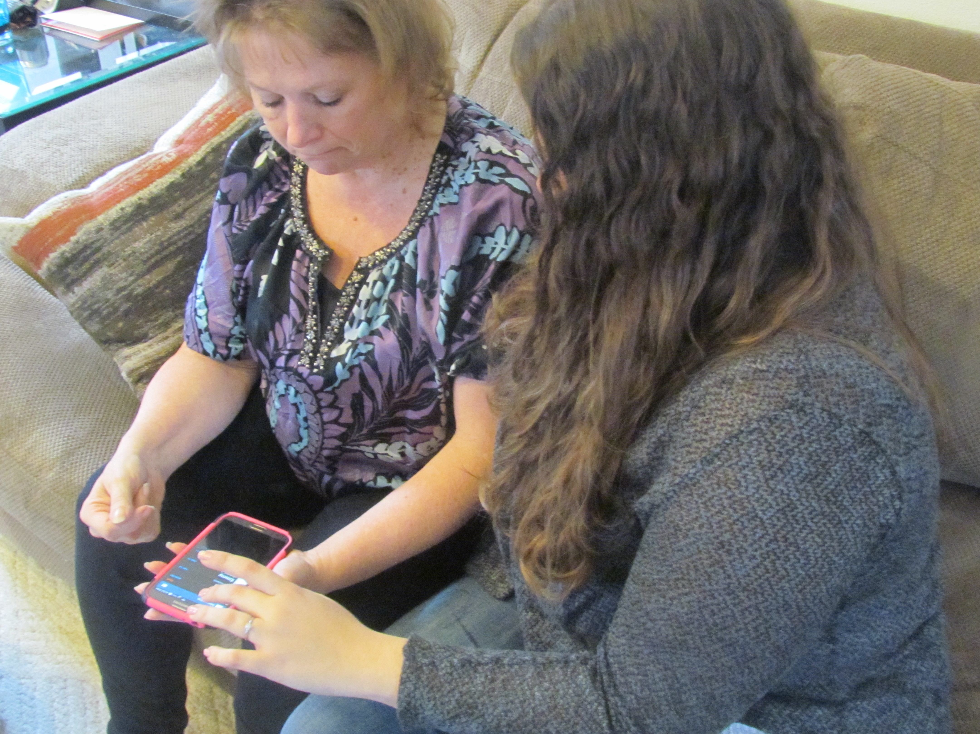
Why I focus on youth in families with HD
Clinical work with families and HD
  School
  Nursing homes
  Community
Research with youth

Slide 3

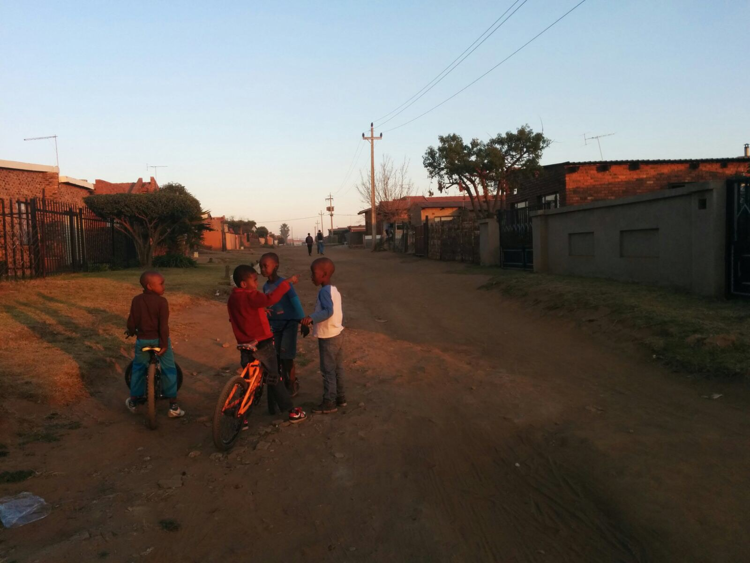
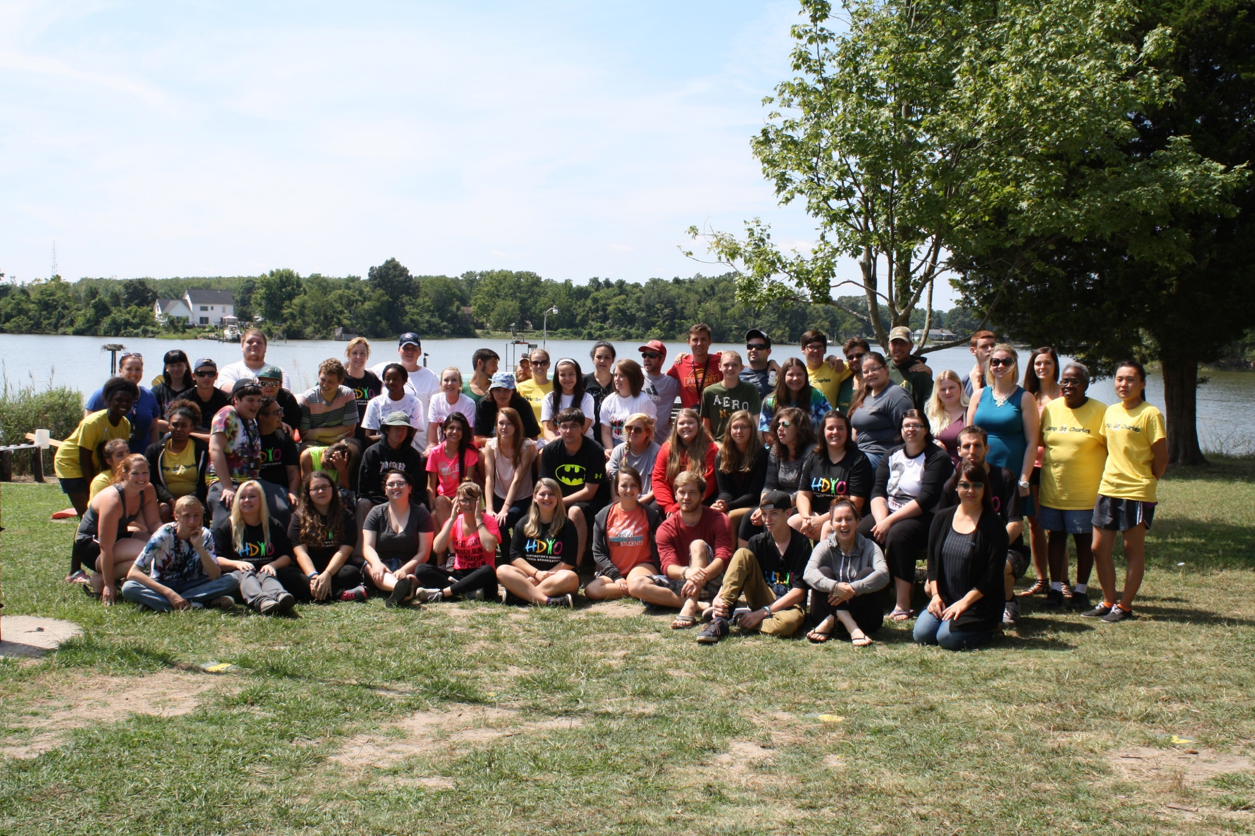
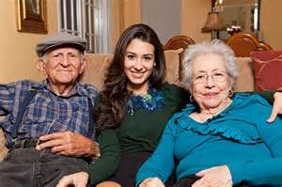
Research Projects
Huntington’s disease
  N = 40 youth
  Ages 8-19
  Parent with HD
ALS
  N = 57 youth
  Ages 8-18
  101 parents with ALS
South Africa ALS
  N = 20 youth
  Ages 8-18
  20 parents with ALS
HDYO Camp
  N = 42 campers
  Ages 15-23
  39 identified as CG
  Family with HD
Dementia and Latino families
  N= 200
  71 identified as CG
  Ages 9 – 14

Slide 4
“Thank you for asking”
Hear the voices of youth to develop support and programs

Slide 5
“if someone says, “How’s your mom doing,” I’ll say, “Oh, she’s doing all right.” But maybe it’d be nice if someone asked me how I was doing. Like, ‘cause I will have an answer.”
- Female, mother with Huntington’s disease

Slide 6
Being a child or youth in a family with HD
Fear
stigma
living At risk
Being a caregiver
Isolation
Family

Slide 7
What do youth say they need? (Kavanaugh, Noh and Studer, 2015)
Friends
Information about HD
Support
Help being a caregiver

Slide 8
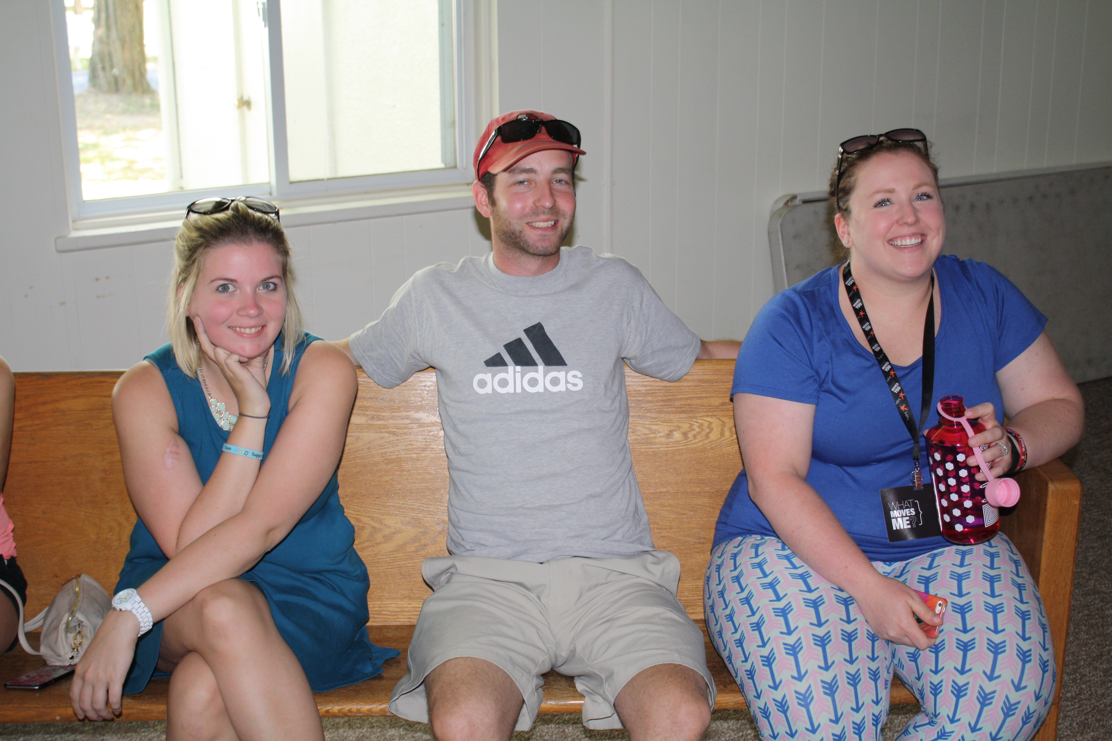
Friends
“I kind of need a friend who supports me more with it because a lot of my best friends just don’t get it and that’s hard”
”I guess just be more understanding because a lot of people don’t understand it…...”

Slide 9
Information about HD
What is HD?
How do I get it?
Can I be tested?
“I guess, just like, more information, like, as, like, things start to progress I don’t really know what, like, if I’m gonna know what to do”

Slide 10
Support
“I need to know that people care. I need someone to talk to. Um, I need someone to distract me, and I need someone to push me.”
“just kind of, um, act normal. Like, we’re a normal family. There’s, you know, nothing different about us than, um, you know the family next door; we just have different issues that we deal with. Yeah, I think that’s about it. Give me support.”

Slide 11
Help being a caregiver
Tasks
Caregiving role
Training
Stressful
Happy to help
Exhausted
Not enough time

Slide 12
Youth Caregiving experiences (Kavanaugh, 2014)
Caregiving average
  4.3 years
Caregiving tasks
  Providing company = 34
  Helping parent walk = 31
  Give medication = 12
  Fed parent=18
  Household chores = 36
  Talk to dr for parent = 13
  Toileting =11
  Feel they have a lot of responsibility = 36
*Depression - Mean = 11
How it affects school
  Absent from school
  Too worried to concentrate
  Missed school activities

Slide 13
Young caregiver life balance
Caregiver
Complicated symptoms
CG Tasks
Child/youth
Mental Health
Physical health
Peer isolation
School problems
Lack of CG training
Notes:
This is important, because it taps into expectations and a “work life” balance that we as adults struggle with. Developmentally, it is hard for a 10 year old to think abstractly about the role they play on either side of the pivot

Slide 14
Developing support interventions
Youth support and respite camps
Caregiving support and education
Disease Education
Using their voices…....

Slide 15

Youth Respite camp (Kavanaugh et al 2017)
  Age Gender Race/Ethnicity
  13-17 15 (43%) Male 12 (34%) White 31 (89%)
  18-20 12 (34%) Female 23 (66%) Black/AA 2 (5%)
  21-23 8 (23%) Hispanic 2 (5%)
  Identify as CG (N=32)
Mixed method survey administered at four time points (waves), 6 weeks prior to camp, first day of camp, last day of camp and 6 weeks after camp
Measures at each time point
      Self esteem
      Life satisfaction
      Social support
      Resilience

Slide 16
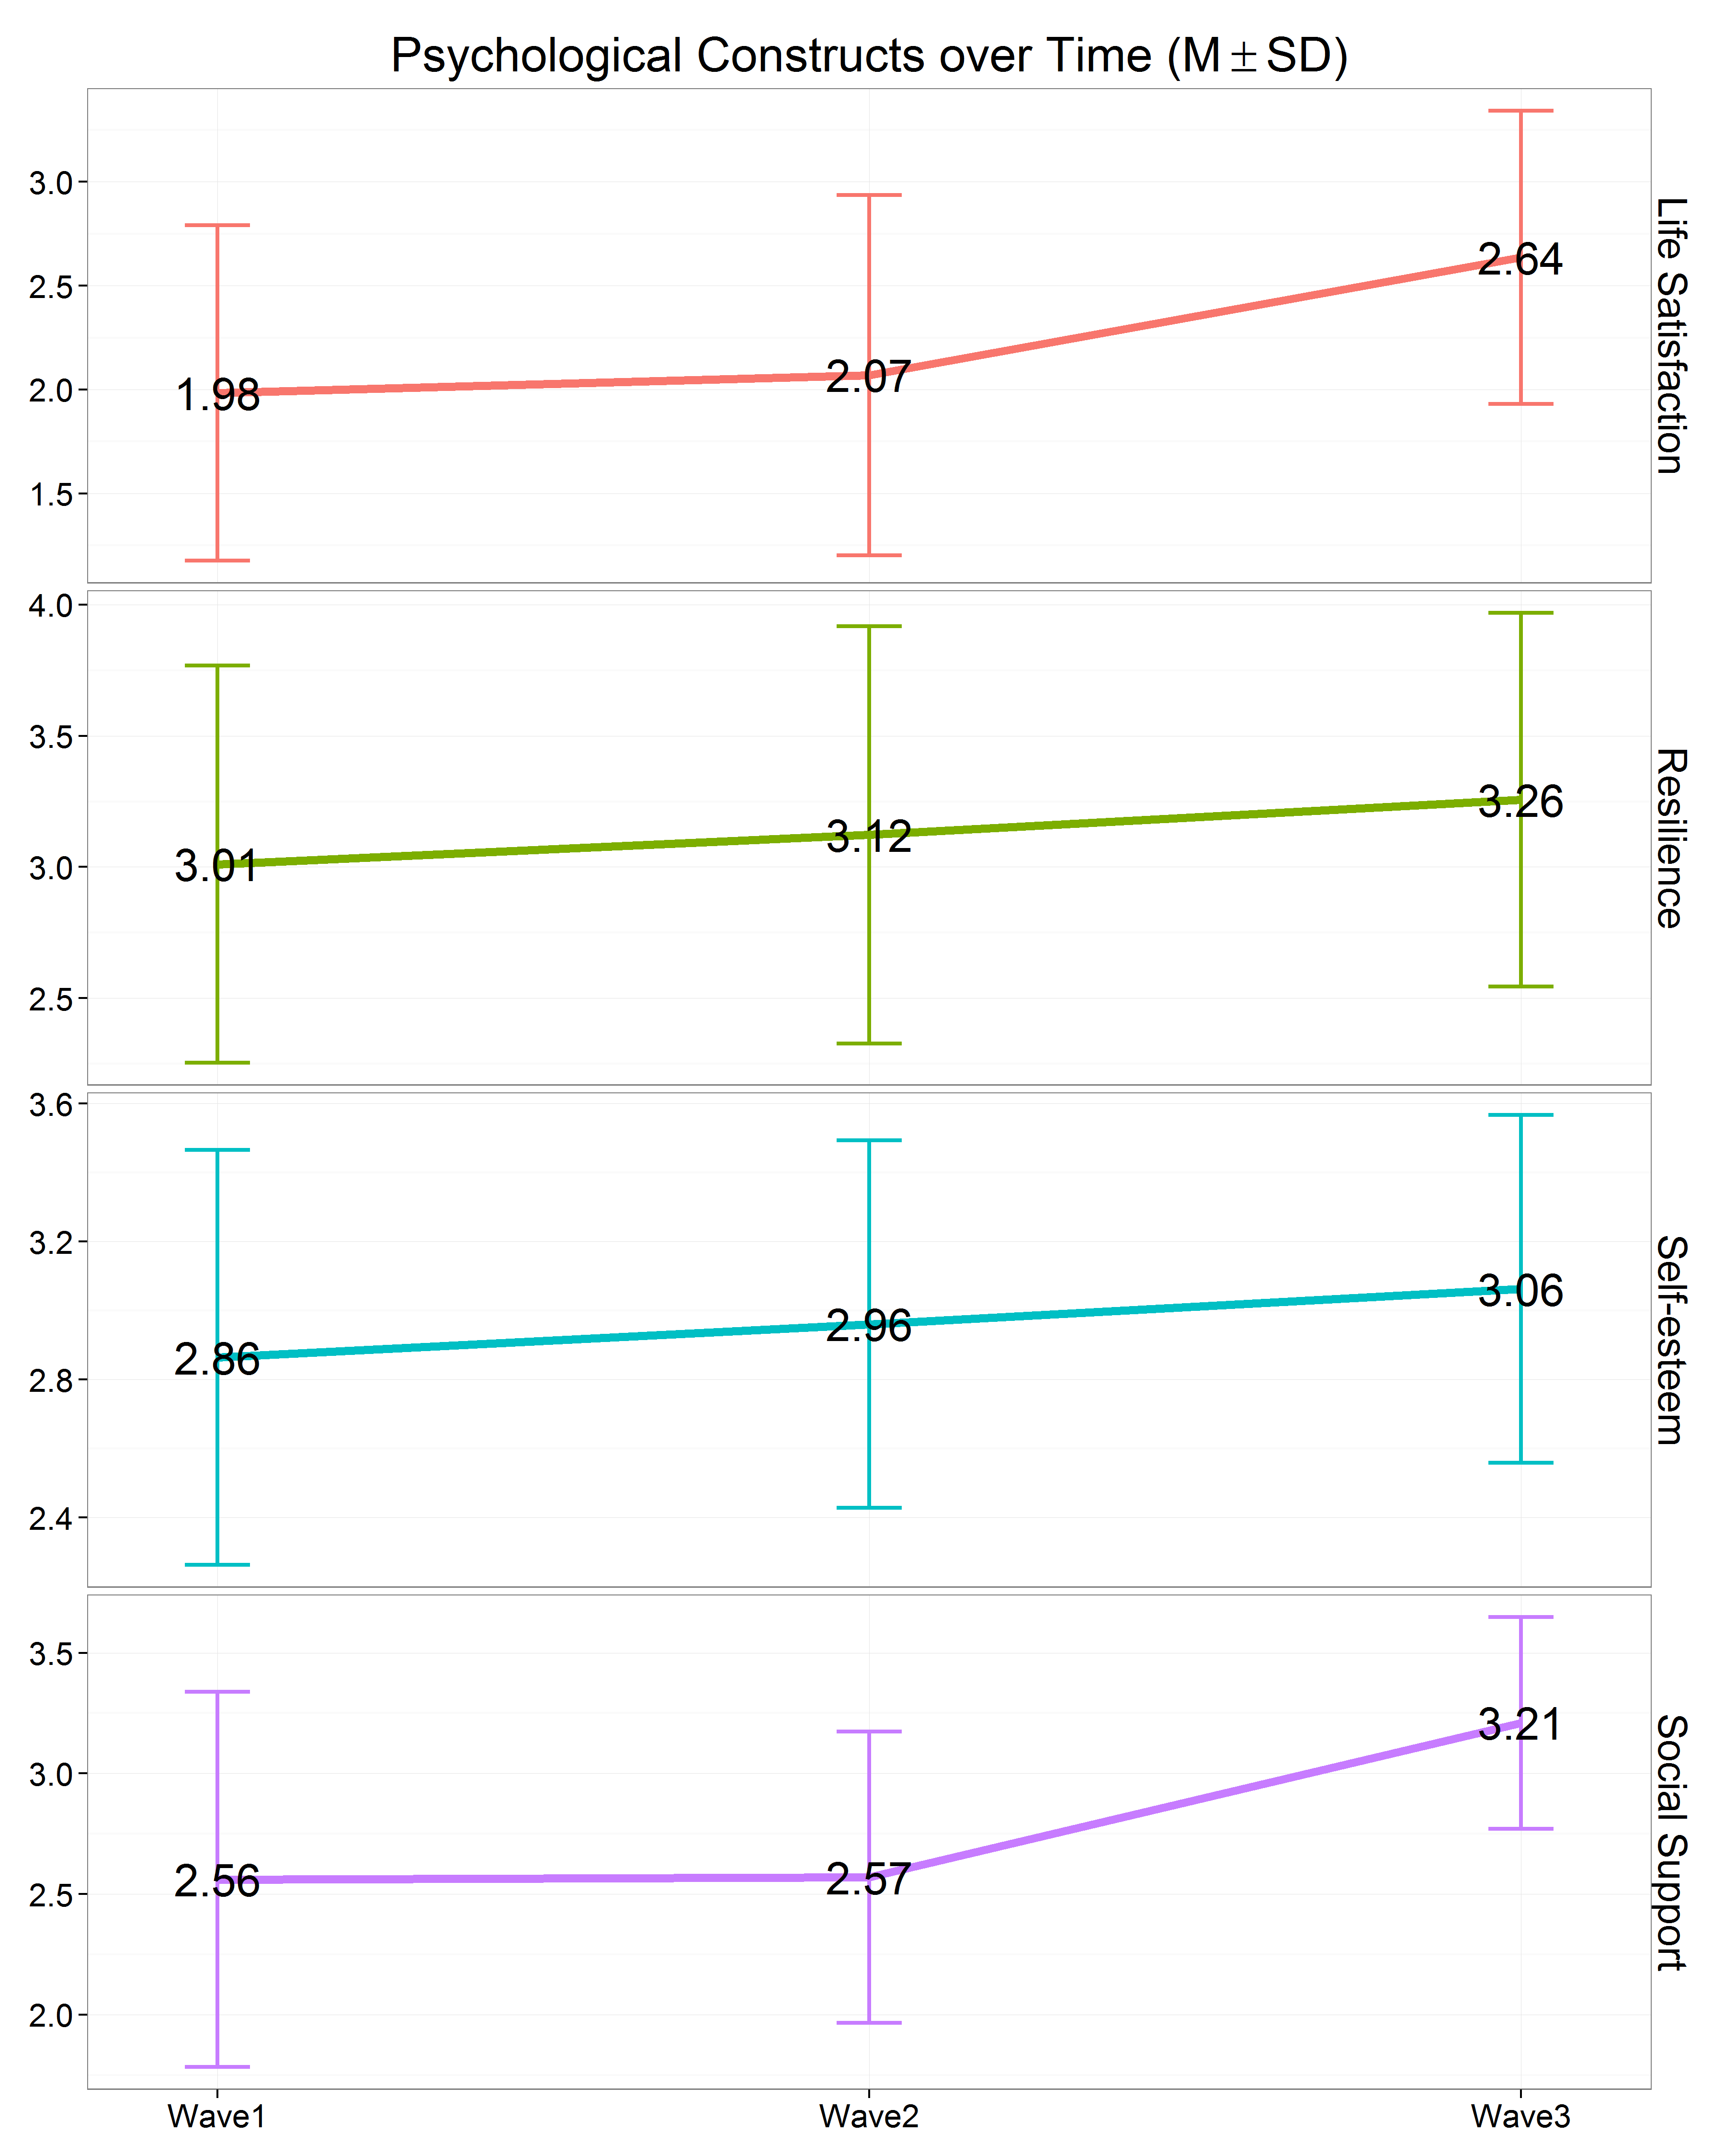
Camp outcomes (Kavanaugh et al, 2017)
No longer alone
Have the skills to cope
Becoming more positive
Information about HD
“I now know I am not the only one going through this and I know that I am not alone in this fight anymore”

Slide 17
Huntington’s Disease education
Education and information comes from a variety of sources
Websites
Organization specific
Mentors
Health care professionals
Notes:
Given the complexity and terminality of HD,

Slide 18
Caregiving guidance and support
“We need more information and guidance about what to do care for her”
“People can talk about it more and give advice for easier and better solutions to caregiving”

Slide 19
Takeaways and next steps
support
CG respite
Disease education
Family support
Elevate youth in the discussion
Research on best practices
Cross country programs
Economic support
Work with other disease organizations

Slide 20
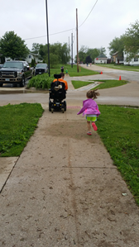
Thank you
Melinda Kavanaugh, PhD, MSW, LCSW
Helen Bader School of Social Welfare
University of Wisconsin-Milwaukee
Milwaukee, WI United States
kavanaug@uwm.edu
Photographs used by permission by those participating in research projects under the direction of Dr. Kavanaugh

Slide 21
References
Bauman, L., Foster, G., Johnson-Silver, L., Berman, R., Gamble, I., & Muchaneta, L. (2006). Children caring for their ill parents with HIV/AIDS. Vulnerable Children and Youth Studies, 1(1), 56-70.
Beach, D. (1997). Family Caregiving: Positive impact on adolescent relationships. The Gerontologist, 37 (2), 233-238.
Diaz, N., Siskowski, C., & Connors, L. (2007). Latino young caregivers in the United States: Who are they and what are the academic implications of this role? Child Youth Care Forum, 36, 131-140.
Forrest Keenan, K., Miedzybrodzka, Z., Teijingen, E., McKee, L., & Simpson, S. (2007). Young people’s experiences growing up in a family affected by Huntington’s disease. Clinical Genetics, 71, 120-129.
Gates, M., & Lackey, N. (1998). Youngsters caring for adults with cancer. Image: Journal of Nursing Scholarship, 30(1), 11-15.
Helder, D., Kaptien, A., Van Kempen, G, Weinman, J., Van Houwelingen, J., & Roos, R. (2002). Living with Huntington’s Disease: Illness perceptions, coping mechanisms and spouses quality of life. International Journal of Behavioral Medicine, 9(1), 37-52.
Hunt, G., Levine, C., & Naiditch, L. (2005). Young carers in the U.S.: Findings from a national survey. Bethesda, MD: National Alliance on Family Caregiving [in collaboration with the United Hospital Fund].
Huntington’s Disease Society of America, (2009). Huntington’s disease: A family guide. New York City, NY: Huntington’s disease Society of America.
Jacobson, S., & Wood. F. (2004). Contributions of children to the care of adults with diabetes. The Diabetes Educator, 30(5), 820-826.
Lackey, N., & Gates, M. (2001). Adults’ recollections of their experiences as young caregivers of family members with chronic illnesses. Journal of Advanced Nursing, 34(3), 320-328
Kavanaugh, MS. (2014). Children and adolescents providing care to a parent with Huntington’s disease: Disease symptoms, caregiving tasks and young carer well-being. Child and Youth Care Forum, 43(6), 675-690.
Kavanaugh, MS., Noh, H., and Studer, L (2015). “It’d be nice if someone asked me how I was doing. Like, ‘cause I will have an answer.” Exploring support needs of young carers of a parent with Huntington’s disease. Vulnerable Children and Youth Studies, 10(1), 12-25

