Slide 1




Coping with HD - how to mobilise your strengths.
Rhona MacLeod
Mariangels Ferrer Duch
EHA Bucharest 5th October 2019

Slide 2
Narrative ideas in Genetic Counselling
Some principles and history of Narrative Practices
Narrative ideas in Genetic Counselling
Section of video
Exercise: Values exercise working in pairs (if time)
Post its - Which one idea will stay with you? How has Cheleigh’s experience touched you? What will you take away from listening to her?

Slide 3
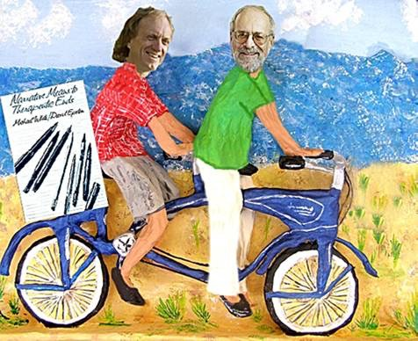
Narrative Origins
Born in the 1980s in Australia-Michael White and New Zealand- David Epston
2014-first time a University (Melbourne University) offers a postgraduate Master in NT and community work.
UK-The Institute of Narrative Therapy: http://theint.co.uk

Slide 4
Narrative therapy seeks to be a respectful, non-blaming approach to counselling and community work, which centres people as the experts in their own lives. It views problems as separate from people and assumes people have many skills, competencies, beliefs, values, commitments and abilities that will assist them to reduce the influence of problems in their lives. (Alice Morgan)

Slide 5
“The person is not the problem the problem is the problem”
“…in this approach to narrative therapy, the problem is viewed as external to the person, located in the broader sociopolitical context and reflected in discourse, rather than within the individual or family”
–Michael White, Madigan & Law

Slide 6

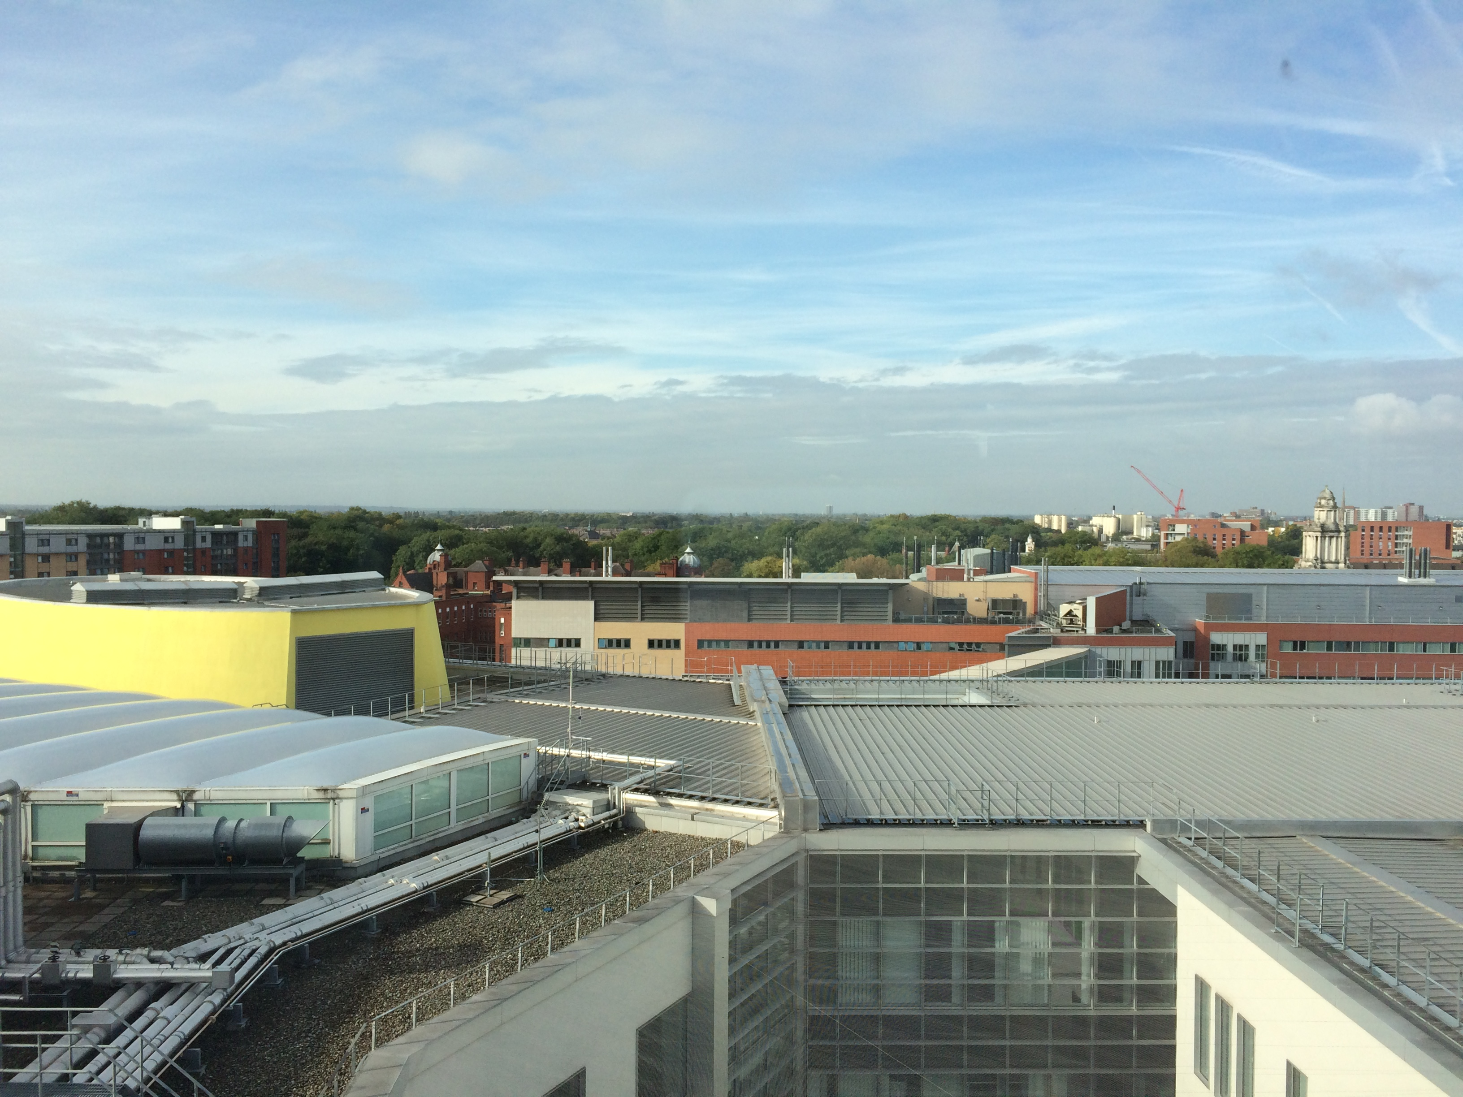

Manchester St Mary’s Hospital

Slide 7
Narrative practices: Related GC projects (supervision, training, practice and research)
  EHDN workshop 2014 & 2018
  MFDG work
  Birmingham GC training workshop/AGNC new GC group
Counselling supervision
2012_
GC training workshops
2013-
MSC Genomic
Counselling
2016-
Narrative group sessions
2015-
  ESRC grant 2019 Podcasts ‘Rare’
  EHDN grant 2016
  HDYO 2020

Slide 8
Narrative & Genetic Counselling
A narrative approach to living with a genetic condition disrupts stories of shame, guilt, fear and despair when facing difficult events in family life.
Shifts from certainty (where we are expert) to collaborative conversations contributing to the substance of our vision and our energy as counsellors and creating opportunities for new identity stories of those who consult us.
The new stories discovered in the course of genetic counselling support the preferred identity of the individuals who consult us.
Externalising and mapping questions that address death, illness and loss (including anticipated losses) create agency to explore and expand the gaps in stories that otherwise can confuse and paralyse families.

Slide 9





EXTERNALISATION
Internalised
Externalised
Collective
person
person
problem
problem
The person is the problem
The person is not the problem
The problem is the problem
The problem is the problem and the solution is collective
Notes:
Within Narrative Therapy we aim to reduce the limiting effects of dominant stories upon people’s lives through externalising. This involves taking a non-judgemental stance towards people underpinned by the key principle ‘The person is not the problem, the problem is the problem’.
it aims to transform the effects of a problem. Its goal is to make space between a person and their issues
Seeing a problem objectively helps couples and families reconnect with the heart of their relationship. They may be able to address how the problem has challenged the core strength of their bond.

Slide 10
We see ourselves as in the process of becoming and being multi-storied :
  Amanda is a nine-year-old cancer patient.
  Amanda is a courageous and loving family member who enriches the lives of her brothers and happens to have cancer in her life.
  Amanda likes to care for others and is committed to ‘not giving up’ in front of difficulties. She contributes greatly to the lives of her brothers and is living with cancer.

Slide 11
We listen carefully to people’s ‘double-storied narrations’, the grief and the small acts of resistance to that grief. People always respond in ways that are available to them, and these responses reflect particular life skills.
Hope can be fostered through relational action, not only by optimism about a preferred outcome but by promoting the ‘doing’ of hope away from isolation.
Re-membering conversations fold the legacies of those who have died into the lives of the living. Through questions, we rescue a ‘club’ of the person’s life with important members (dead or alive) that will accompany him or her in the chosen journey.

Slide 12
Glenda Fredman

Slide 13
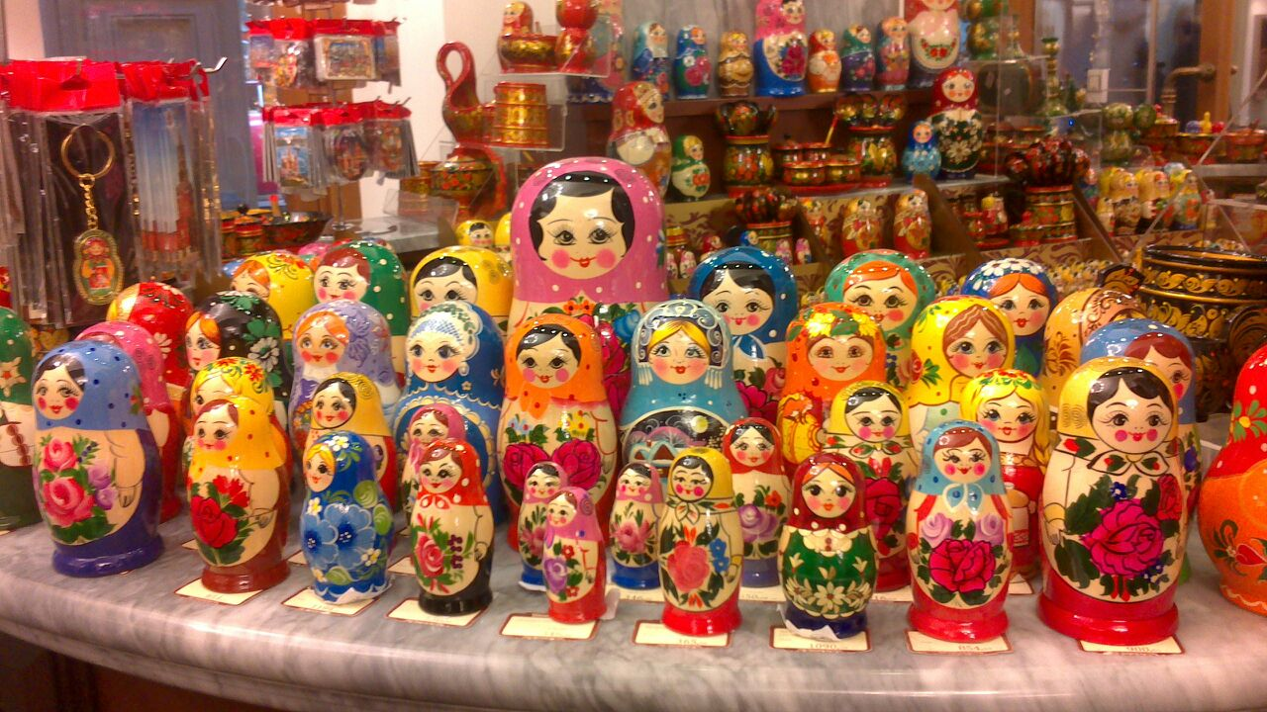

Identity categories
from Michael White’s Workshop Handouts (Available at www.narrativepractices.com.au)
Structuralist/naturalistic identity categories | Non Structuralist/intentional state identity categories
Drives | Purposes
Traits | Conscious intentions
Needs | Wishes
Unconscious Motivations | Values
Disorders | Hopes and Dreams
Natural aptitudes | Principles
True self | Commitments

Slide 14
The professional’s Posture
http://www.dulwichcentre.com.au/michael-white-workshop-notes.pdf
The way we do listen: DOUBLE LISTENING
 |  | Centred
Influential | De-centred and influential (potentially invigorating of therapist) | Centred and influential (potentially burdening of therapist)
Non-influential | De-centred and non- influential (potentially invalidating of therapist) | Centred and non-influential (potentially exhausting of therapist)
It is our intention as therapist to take up a “de-centred and influential" posture in the conversations with the people who consult us – to develop therapeutic practices that make it possible for us to occupy the top-left quadrant.
De-centred

Slide 15
Video clip 4 mins

Slide 16


Exercise in pairs
Values exercise

Slide 17
Which one idea will stay with you from today? How has Cheleigh’s experience touched you? What would you say to her in response? What will stay with you from listening to her? Will you be doing or thinking something different on account of having been here?

Slide 18
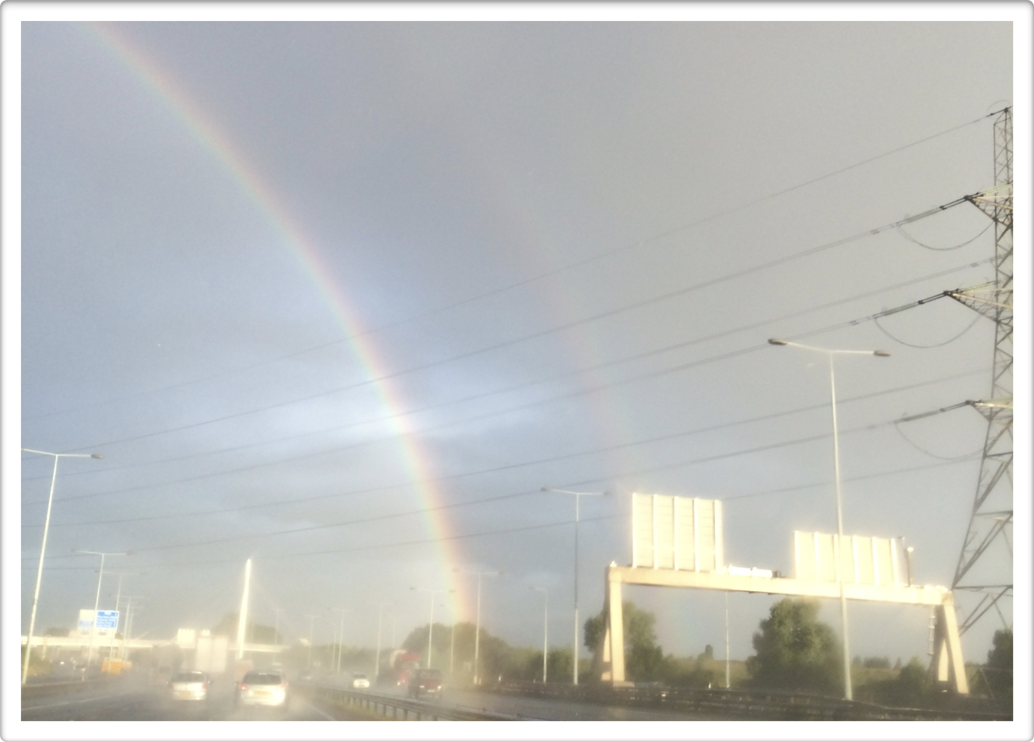
Thank you
Rhona McLeod & Mariangels Ferrer
www.riverbankpsychology.co.uk

Slide 19
Links&Further reading
www.dulwichcentre.com.au
www.theinstituteofnarrativetherapy.com
M.White: Narratives of Therapists Lives (1997) & Narrative Practice and Exotic Lives: resurrecting diversity in everyday life (2002) Maps of narrative practice (2007)
M. White & A. Morgan (2006) Narrative Therapy with Children and their Families
Shona Russell & Maggie Carey: Narrative Therapy, responding to your questions (2004)
D. Denborough (2014) Retelling the stories of our lives. Everyday Narrative therapy to Draw inspiration and transform experience. Norton
Weingarten, K. (2003). Common Shock. Witnessing violence everyday. How We are Harmed, How We can Heal. Dutton.
Weingarten, K. (2010). Reasonable Hope: Construct, Clinical Applications, and Supports. Family Process

